Slide 1
Paper Review 2022. 1. Yaqi Yu
TimeSformer
Background
NLP vs CV
Conv Limitation
Method
Encoder-attention
Encoder-MLP
Structure Design
Experiments

Slide 2
TimeSformer
2021.2.24
Background:
CV VS NLP
Video understanding and NLP Tasks have some similarity：
1. Sequential: videos and sentences are both sequential
2. Contextual: the meaning of a word can often be understood only by relating it to the other words in the sentence
Long –range self-attention models from NLP to be highly effective for video modeling
1. long-range dependencies
2. different space-time locations

Slide 3
TimeSformer
Background:
Convolutional Models Limitation:
Strong Inductive Biases
Local connectivity
Translation equivariance
Short Range Temporal-spatial Information
Costly
Time-Space Transformer Based on ViT

Slide 4
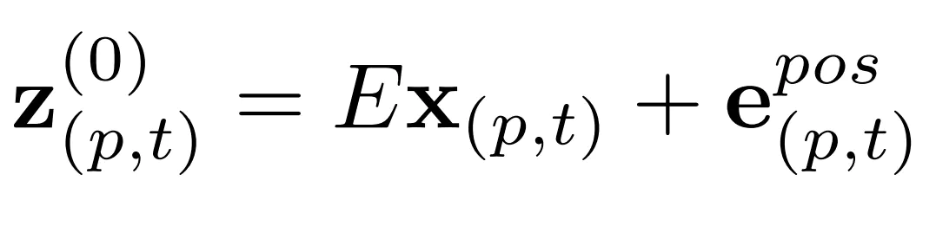
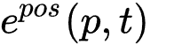
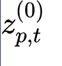
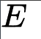
TimeSformer
TimeSformer Method
Input obtain embedding vector
Input Clip X: F RGB frams of H * W
Patches: Decompose each frame into N patches, each of size P*P
Linear embedding: linearly map each patch embedding
positional embedding vector:
embedding vector:
learnable matrix:

Slide 5
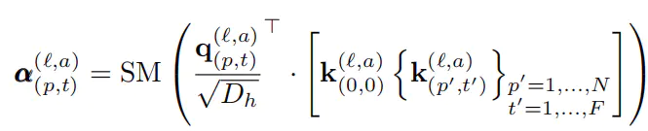
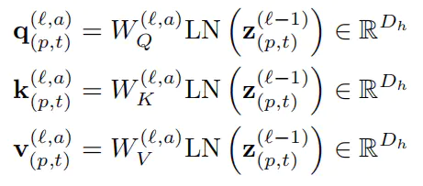
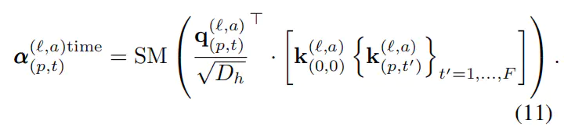
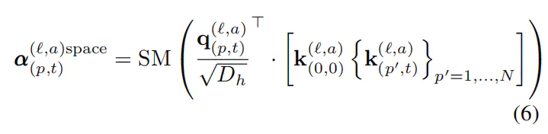
TimeSformer
TimeSformer Method
2. Encoder-Attention
Self-attention Computation(Joint Space-time attention):
SM: SoftMax activation function
a: aTH attention
Dh: attention dimension
k: different value for space or time
Spatial-only or temporal-only attention:
Q-K-V Computation:
compute for each patch from the preceding block vector
LN() denotes LayerNorm operation

Slide 6
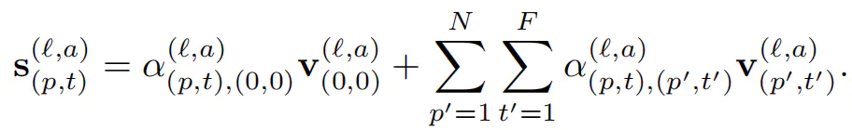
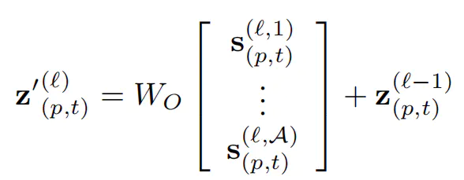
TimeSformer
TimeSformer Method
2. Encoder-Attention
Association information’s between the current patch and adjacent patches in space/time
Short-cut operation
Concatenation of these vectors from all heads

Slide 7
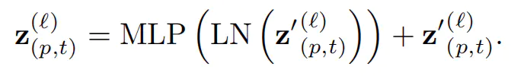
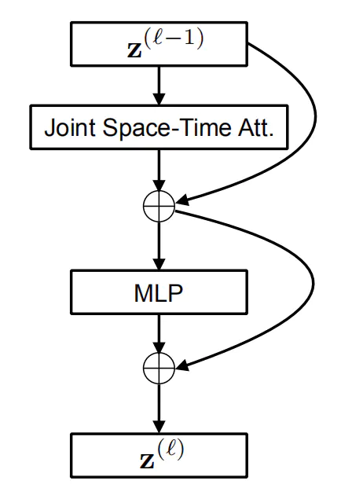
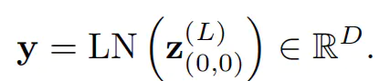
TimeSformer
TimeSformer Method
3. Encoder-MLP
The concatenation of these vectors from all heads is projected and passed through an MLP
Final block for the classification token

Slide 8
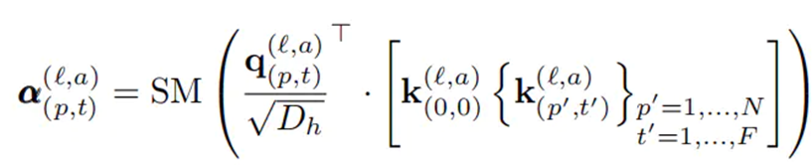
TimeSformer
Structure design
Joint Space-time Attention:
Reduce the computational cost
Neglect to capture temporal dependencies

Slide 9
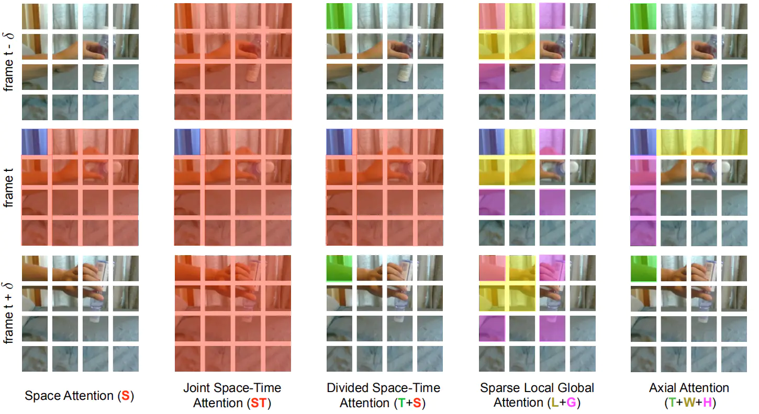
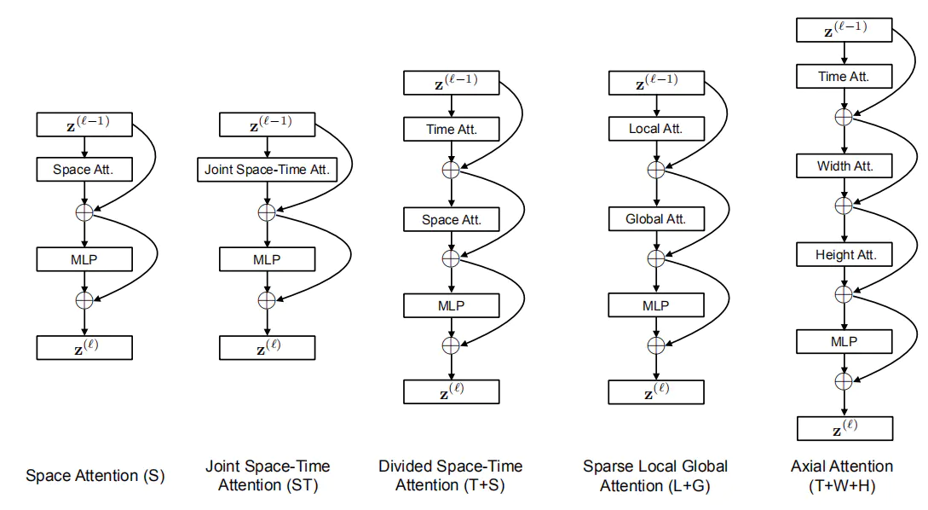
TimeSformer
Structure design
Divided Space-Time Attention(T+S)
Temporal attention and spatial attention are separately applied one after the other

Slide 10
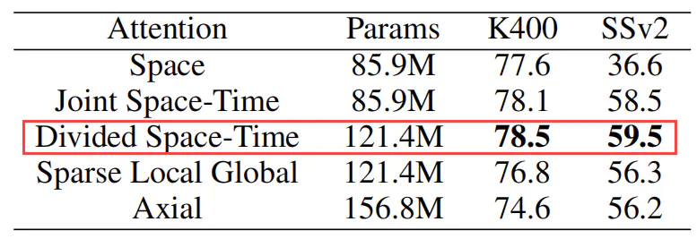
TimeSformer
Experiments
Dataset: Kinetics-400，Kinetics-600， Something-Something-v2，Diving-48
The `Base` ViT pretrained on ImageNet
Clip: 8*224*224
Frames sampled at a rate of 1/32
Patch size: 16*16
Use 3 spatial crops(top-left, center, bottom-right) from the temporal clip and obtain the final prediction by averaging the scores for these 3 crops

Slide 11
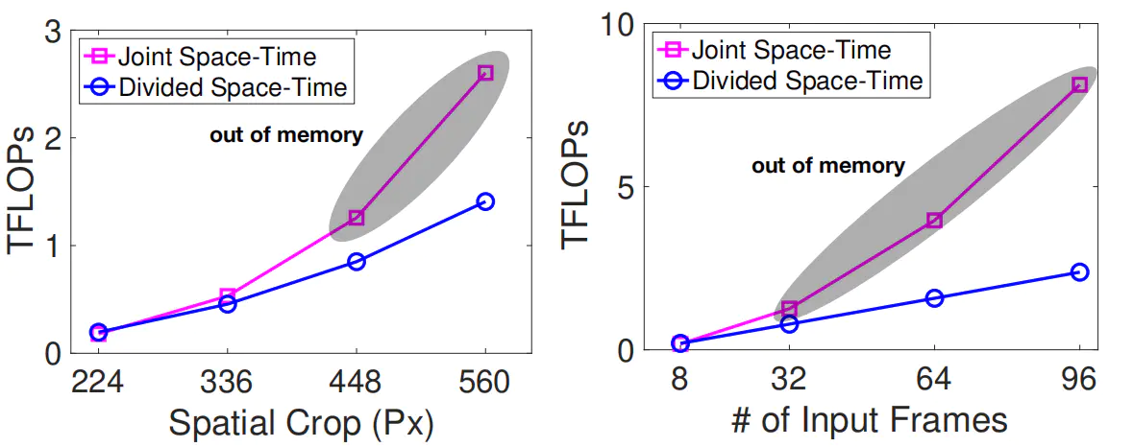
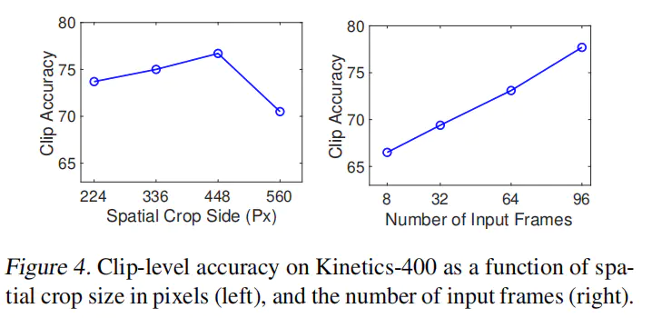
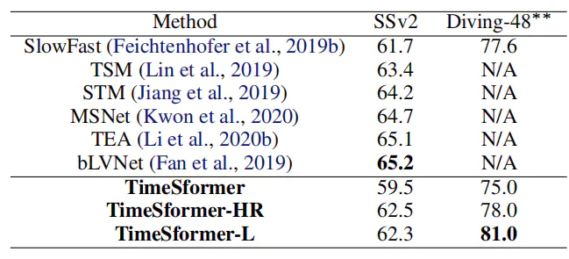
TimeSformer
Experiments
The video classification cost (in TFLOPs)
Increase frame/patch

Slide 12
Paper Review 2022. 1. Yaqi Yu
VTN
Objective
Method
2D spatial feature extraction
Temporal-base encoder
Classification MLP Head
Experiments

Slide 13
VTN(Video Transformer Network)
2021.2
Inspired by ViT
Objective:
Transformer for video problem: How do we build input sequences
ViT divided into different patches as input sequences
Video?
Efficiency：
It trains 16.1X faster
And runs 5.1 X faster

Slide 14
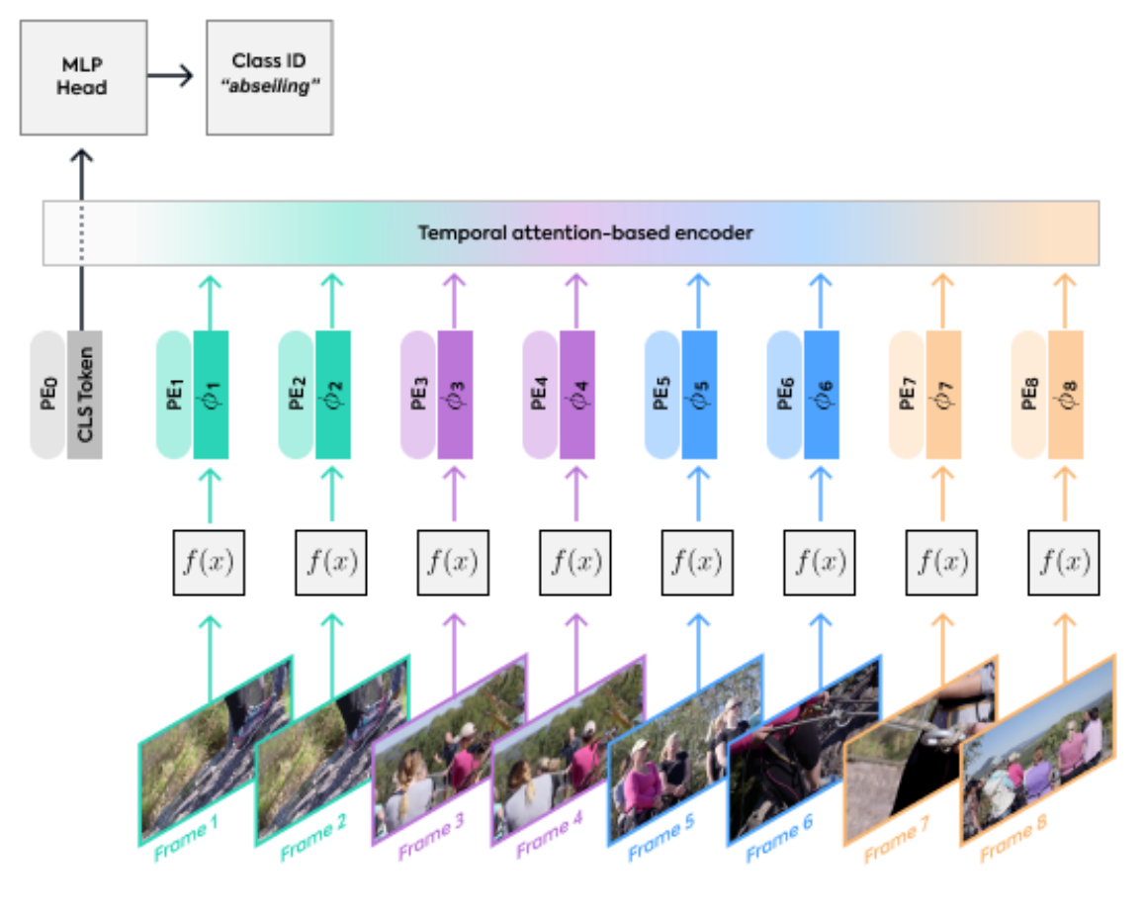
VTN(Video Transformer Network)
2021.2
Inspired by ViT
Method:
The VTN model can be divided into three parts
2D spatial feature extraction:
Spatial backbone
Extract each frame image feature, which can be used CNN/ ViT(entirely TRM)
Its weights can be fixed in pre-trained/ random initialization(with Longformer training)
2D Spatial backbone (f(x)): feature extraction

Slide 15
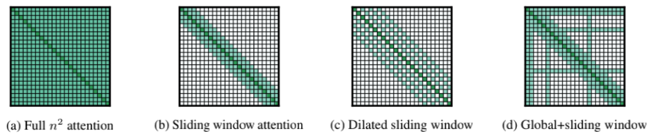
VTN(Video Transformer Network)
2021.2
Inspired by ViT
Method:
The VTN model can be divided into three parts
2. Temporal-base encoder
using Longformer structure
using feature combined with a position encoding
Original Transformer Problems for video:
The video is long and has many frames.
How to handle long sequence problems?
Longformer can process a long sequence of thousands of tokens.
And maintain global attention

Slide 16
VTN(Video Transformer Network)
2021.2
Inspired by ViT
Method:
The VTN model can be divided into three parts
3. Classification MLP Head:
the classification token is processed with an MLP head to provide a final predicted category

Slide 17
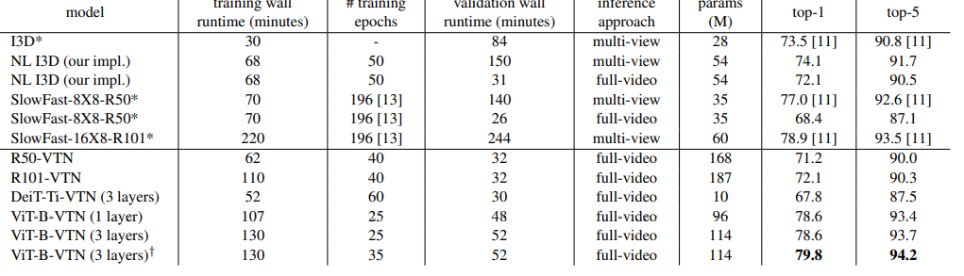
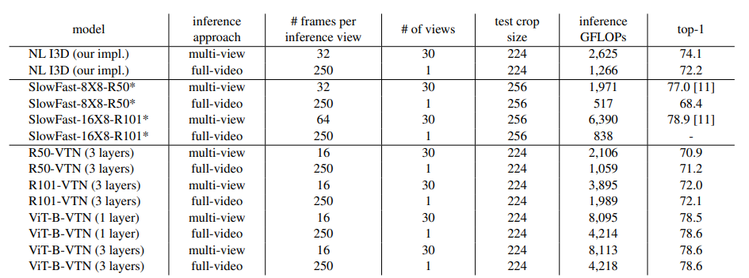
VTN(Video Transformer Network)
2021.2
Inspired by ViT
Experiments:
VTN performance on Kinetics-400 Dataset
Subsequent work can be done based on VTN, the effect is much better than 3D convolution. The method in this paper has a very good progress in the amount of calculation, running time and accuracy

Slide 18
Paper Review 2022. 1. Yaqi Yu
Video Swin Transformer
Background
Motivation
Method
Overall Architecture
3D Shifted Window based MSA Module
Initialization for Pre-trained Model
Experiments

Slide 19
Video Swin Transformer
2021.6
Background:
Vision community: CNNs to Transformers
Pure transformer architectures: globally connect patches across the spatial and temporal dimensions
Video Swin Transformer: inductive bias of locality in order to better trade-off
The locality: Based on Swin Transformer architecture
Per-trained image models improve generalization ability of video model

Slide 20
Video Swin Transformer
2021.6
Motivation:
CNNs to Transformers began with ViT
The success of ViT mainly lies in capturing the global relationship between non-overlapping patches
3D conv is direct extension of 2D conv for joint spatial and temporal modeling(not economical or easy to optimize)
Decompose space-time modeling to achieve better speed-precision tradeoffs(Transformer)
This paper present a pure-transformer backbone architecture for video recognition: pixel that are closer to each other in spationtemporal distance are more likely to be correlated (through Swin Transformer)

Slide 21
Video Swin Transformer
2021.6
Motivation:
Video Swin Transformer through a spatiotemporal adaptation of Swin Transformer
Strictly follows the hierarchical structure of the Swin Transformer
Also extend the scope of local attention computation from only the spatial domain to the spatiotemporal domain.
The sliding window mechanism of the original Swin Transformer has also been redefined to accommodate information in both the temporal and spatial domains

Slide 22
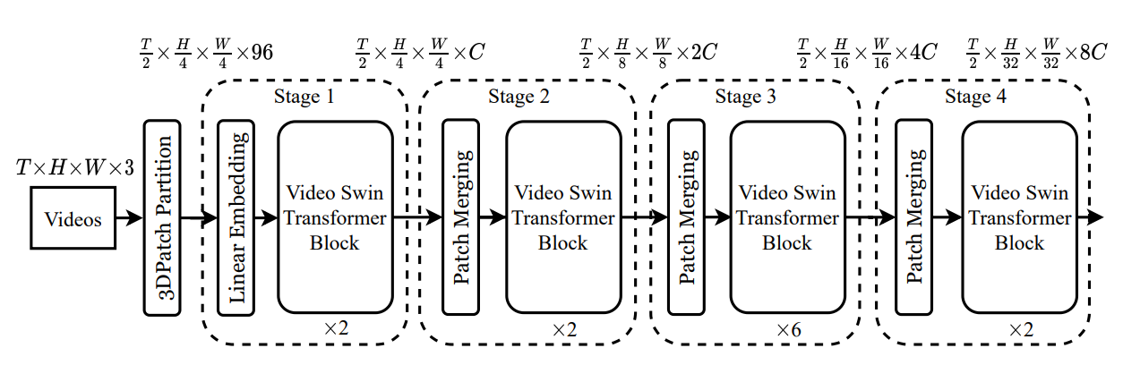
Video Swin Transformer
2021.6
Method:
1. Overall Architecture
The basic structure of Video Swin Transformer is very similar to that of Swin Transformer, which is equivalent to adding frame (time) dimension to model calculation

Slide 23
Video Swin Transformer
2021.6
Method:
1. Overall Architecture
Video to token
Input video: T*H*W*3(T frames each contain H*W*3 pixels)
3D Patch size: 2*4*4*3
Linearly embedding and Position embedding
Model stages
Including: video swin transformer block, patch merging
Video swin transformer block:
- video W-MSA (added window)
- video SW-MSA (added shift window)
Head
high-dimensional features requires simple frame fusion(I3DHead)

Slide 24
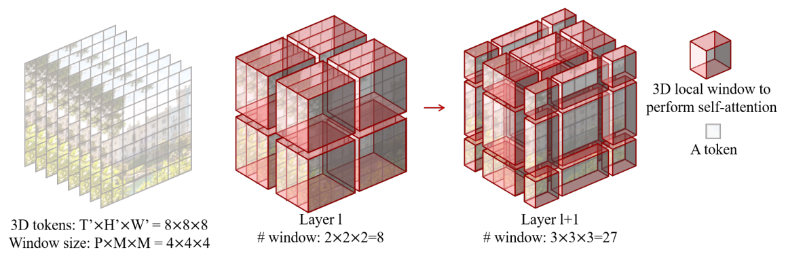
Video Swin Transformer
2021.6
Method:
2. 3D Shifted Window based MSA Module
More token More cost
Locality inductive bias to the self-attention module
the windows are arranged to evenly partition the video input in a non-overlapping manner

Slide 25
Video Swin Transformer
2021.6
Method:
2. 3D Shifted Window based MSA Module
3D Relative Position Bias
Introducing 3D relative position bias B

Slide 26
Video Swin Transformer
2021.6
Method:
3. Initialization for Pre-trained Model
Adapted from Swin Transformer
Only two building blocks different from Swin Transformers
1. Linear embedding layer in the first stage
96*C VS 48*C (due to input token is inflated to a temporal dim of 2)
2. Relative position bias matrix
(2P-1,2M-1,2M-1) VS (2M-1,2M-1)

Slide 27
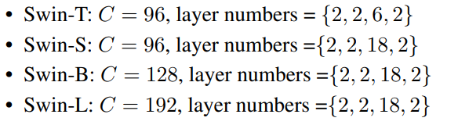
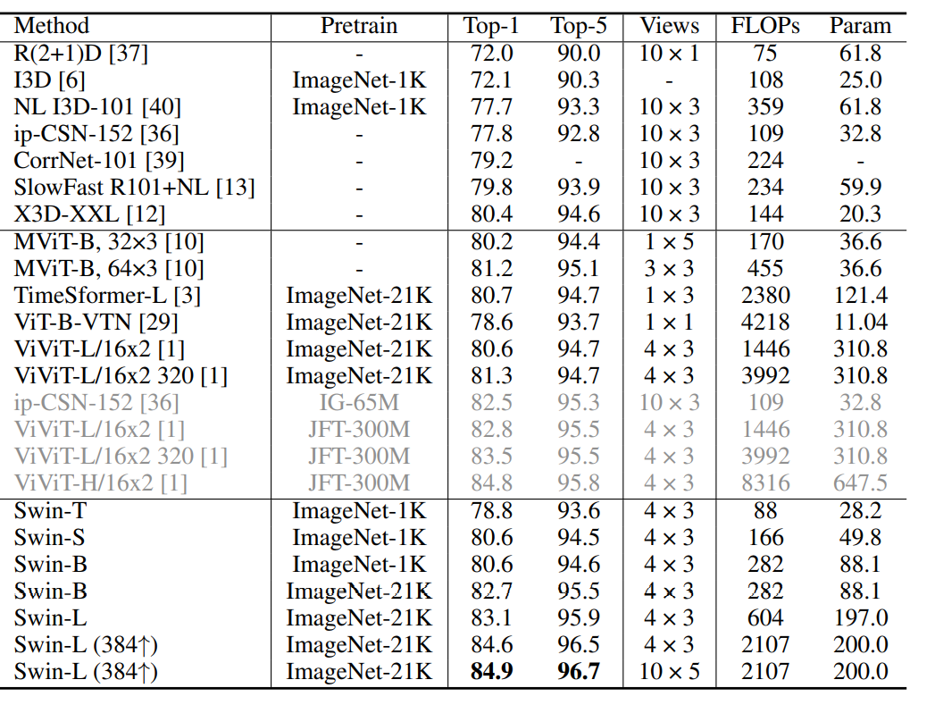
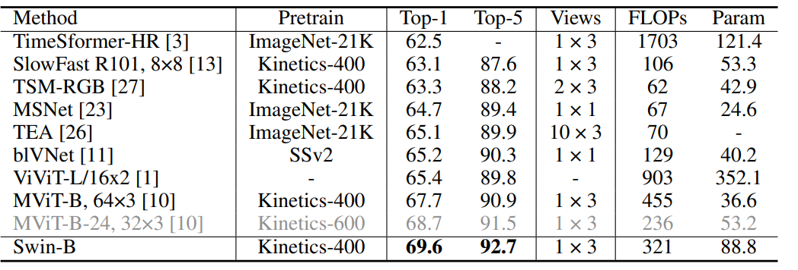
Video Swin Transformer
2021.6
Experiments:
Four different versions of Video Swin Transformer
Kinetics-400
Something-Something v2

Slide 28
Paper Review 2022. 1. Yaqi Yu
X-ViT
Background
Motivation
Method
Video Transformer
Space-time mixing attention
Temporal Attention aggregation
Summary token
Experiments

Slide 29
X-ViT
2021.6
Background:
Computational overheads due to the additional modelling of the temporal information
X-ViT scales linearly with the number of frames in the video sequences
X-Vi-T two approximations to the full space-time attention:
1. Restrict time attention to a local temporal window
2. Using efficient space-time mixing to attend jointly spatial and temporal locations

Slide 30
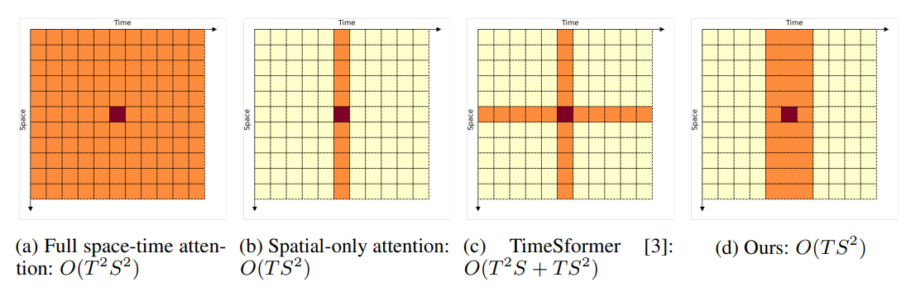
X-ViT
2021.6
Motivation:
Vision Transformers: perform the self-attention jointly across all S spatial locations and T temporal locations
Complexity: O(T^2 S^2)
Spatial-Only attention: temporal averaging
Complexity: O(T S^2)
TimeSformer attention: overheads compared to the spatial-only transformer(additional temporal infor.)
Complexity: O(T^2S +TS^2)
X-ViT: Complexity: O(TS^2). Accuracy/FLOP than others

Slide 31
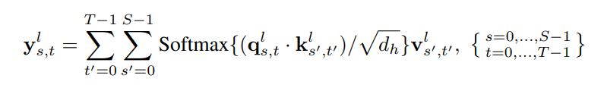
X-ViT
2021.6
Method:
1. Video Transformer
Input video clip:
Patches: each frame is divided into K*K non-overlapping patches
using linear embedding layer mapping into visual tokens
Positional embedding: For space, for time
positional embedding be added to the visual tokens
The visual token at layer l, spatial location s, temporal location t
Single full space-time Self-Attention head:

Slide 32
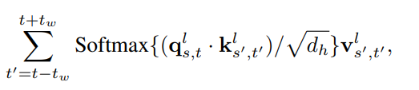
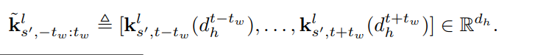
X-ViT
2021.6
Method:
2. Space-time mixing attention
TimeSformer: temporal attention is performed for a fixed spatial location which is ineffective when misalignment between frames
X-ViT first approximation to perform full space-time attention but restricted to a local temporal window
X-ViT second approximation: efficient space-time mixing to attend jointly spatial and temporal locations
Shift trick: perform both zero-cost dimensionality reduction, space-time mixing and attention

Slide 33
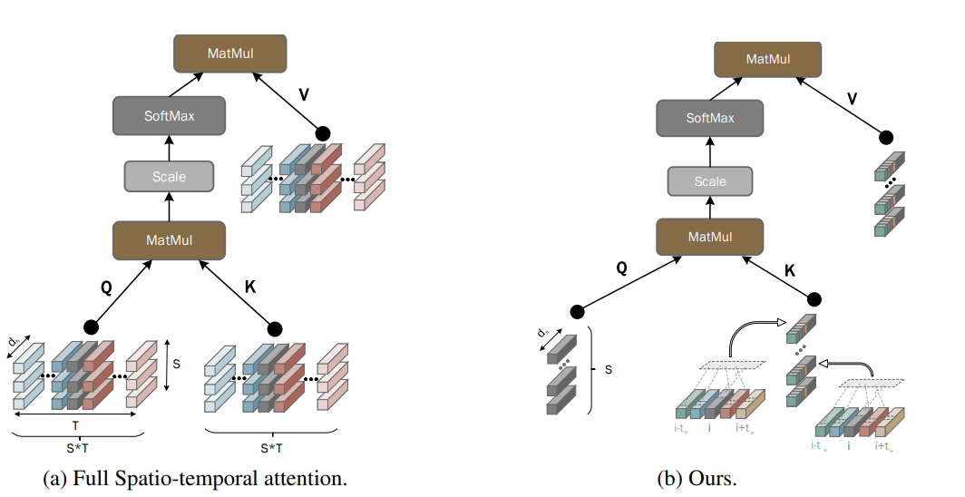
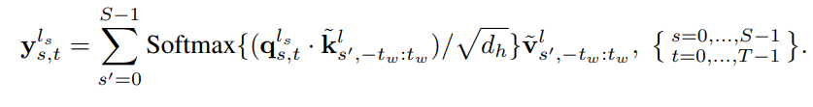
X-ViT
2021.6
Method:
2. Space-time mixing attention
Shift trick: perform both zero-cost dimensionality reduction, space-time mixing and attention
Construct new key vector
Construct new value vector
Space-time mixing approximation:

Slide 34
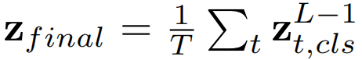
X-ViT
2021.6
Method:
3. Temporal Attention aggregation
The final set of the class tokens are used to generate the predictions
Two method aggregate temporal information:
1. simple temporal averaging
temporal averaging is that the output is treated purely as an ensemble of per-frame features.
ignores the temporal ordering between them
2. lightweight Temporal Attention(TA) mechanism
attending the sequence using a temporal Transformer layer and then fed as input to the classifier

Slide 35
X-ViT
2021.6
Method:
4. Summary token
Exchange information between different frames at intermediate layers of the network
Summary token summarize the frame information
X-ViT: Space-time mixing attention; and lightweight global teporal attention

Slide 36
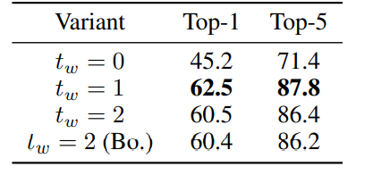
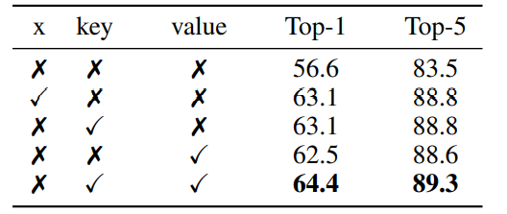
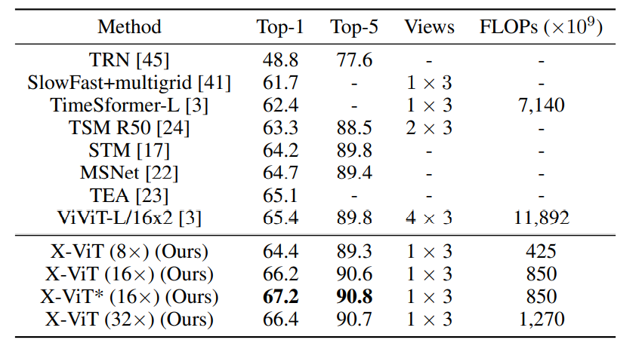
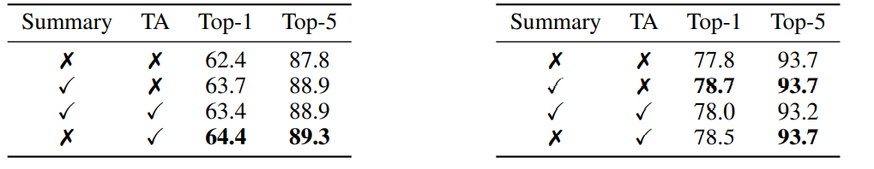
X-ViT
2021.6
Experiments:
Effect of local window size:
Effect of space-time mixing
Comparison with state-of-the-art on SSv2
Comparison between TA and Summary token on SSv2 (left) and Kinetics-400 (right)

Slide 37
Paper Review 2022. 1. Yaqi Yu
Multiscale Vision Transformers
MViT
Motivation
Method
Multi Head Pooling Attention
Experiments

Slide 38
MViT
2021.4
Motivation:
MViT by connecting the seminal idea of multiscale feature hierarchies with transformer
ViT Drawback
MViT have several channel-resolution scale stages, which expand the channel capacity
MViT create a multiscale pyramid of feature activations inside the transformer network, connecting the principles of transformers with multiscale feature hierarchies

Slide 39
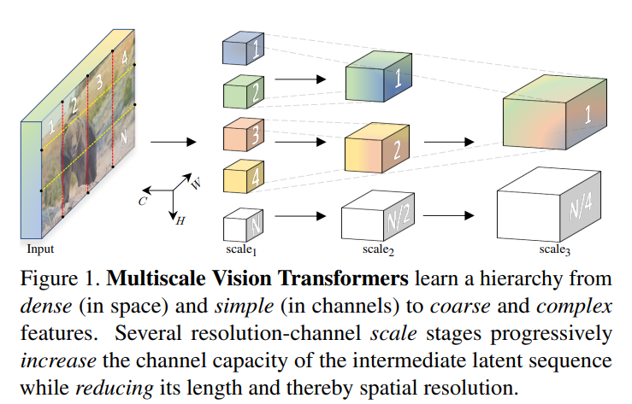
MViT
2021.4
Method:
1. operate at high spatial resolution to model simple low-level visual information
2. the deeper layers can effectively focus on spatially coarse but complex high-level features to model visual semantics

Slide 40
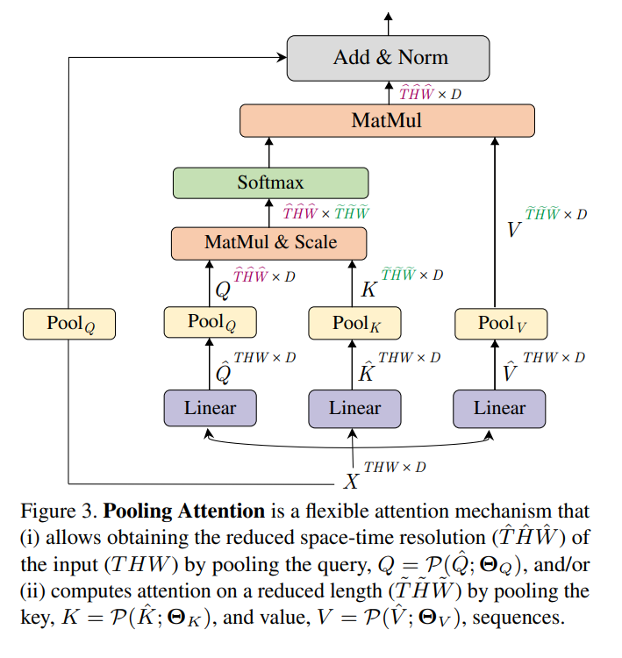
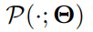
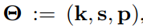
MViT
2021.4
Method:
Multi Head Pooling Attention
The main idea of MViT is to expand the channel capacity, while pooling the resolution from input to output
The channel dimension and the spatio-temporal resolution remains fixed, MHPA pools the sequence of latent tensors to reduce the sequence length of the input
Pooling Operator: performs a pooling kernel computation on the input tensor along each the dim
kernel, stride, padding

Slide 41
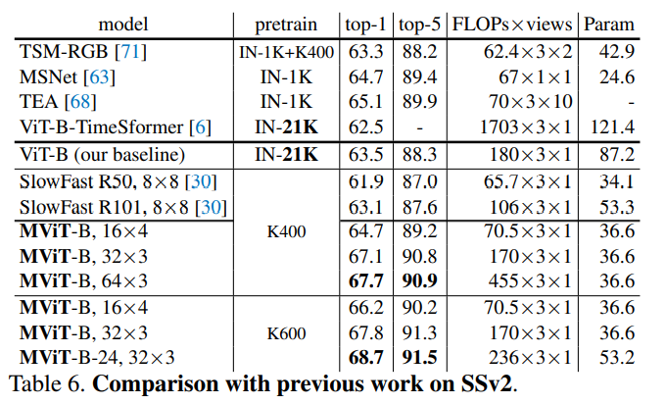
MViT
2021.4
Experiments:

Slide 42
Paper Review 2022. 1. Yaqi Yu
Masked Feature Prediction for Self-Supervised Visual Pre-Training
MaskFeat
Motivation
Method
Experiments

Slide 43
MaskFeat
2021.12
Motivation:
Self-supervised pre-training has been successful in NLP powering large-scale Transformers
Difference between CV and NLP is that vision has no pre-existing voca. to shape the prediction task in to a well-defined classification problem
BEiT: by building a visual vocabulary that discretizes frame patches into tokens
But, an external tokenizer which can be limited in video tasks.
Masked Feature Prediction: masked space-time input
predicts a certain feature representation of the masked content
5 different types of features: applied HOG(Histogram of Oriented Gradient)

Slide 44
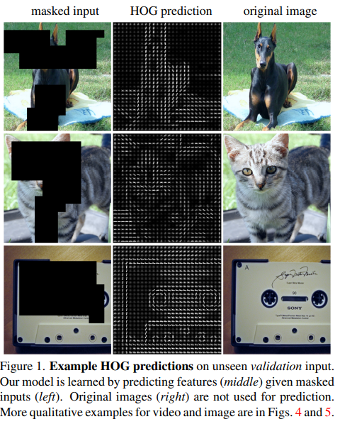
MaskFeat
2021.12
Motivation:
Simple HOG is a effective target for MaskFeat in terms of
both performance and efficiency
The tokenization of visual is not necessary for masked
visual prediction.
MaskFeat can pre-train large-scale video models that gene-
ralize well

Slide 45
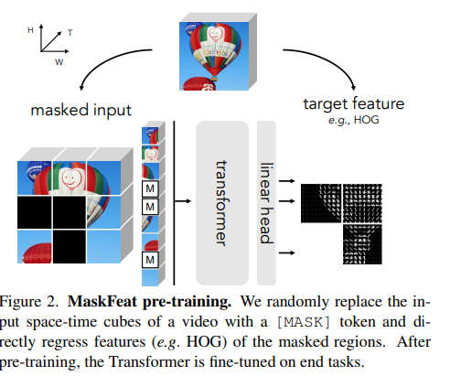
MaskFeat
2021.12
Method:
A video is first divided into space-time cubes as in typical video Vision Transformers. The cubes are then projected to a sequence of tokens
Some of the tokens in the sequence are randomly masked out by beding replaced with a [MASK] token. (a learnable embedding indicating masked patches)
With positional embedding added, is processed by the Transformer. Output tokens corresponding to the masked cubes are projected to the prediction by a linear layer.
The prediction is simply the feature of the 2-D spatial patch temporally centered in each masked cube

Slide 46
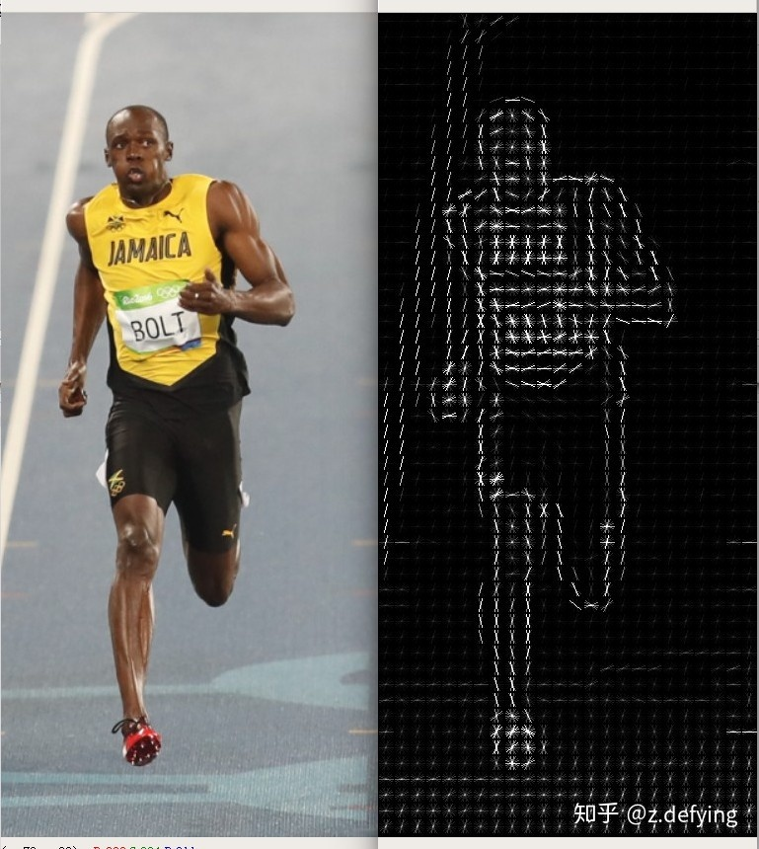
MaskFeat
2021.12
Method:
Target Features:
1): one-stage targets: pixel colors and HOG
It can be directly obtained
2): tow-stage targets: extracted by a trained deep network, extra computational cost
Pixel colors: use RGB values that are normalized by the mean and the standard deviation of the dataset. Minimize the l2 distance
HOG: 1. obtain a HOG feature map on the whole image
2. Split the map into patches(reduce padding on boundaries of each
masked patch)
3. Flattened and concatenated into a 1-D vector as the target feature
loss minimizes the l2 distance between the predicted and original HOG feature

Slide 47
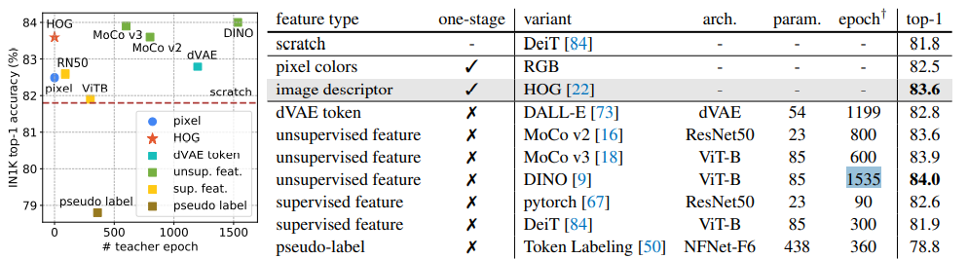
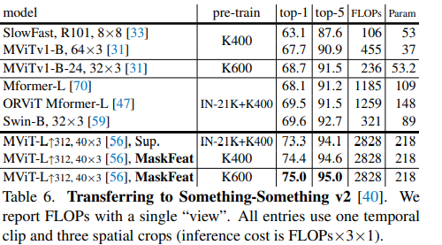
MaskFeat
2021.12
Experiments:

